Slide 1
Modeling and Analysis of Component Worker Thread Scheduling using CPN Research Update
Pranav Srinivas Kumar
2013.12.16

Slide 2
Goals
Model
Component Worker Thread.
Temporal Partition Scheduling.
Operation of Scheduler.
Model Component operations [WiP].
Model operation dependencies [WiP]
Design Time Analysis
Generic Questions
Terminating, deadlock-freedom, liveness, boundedness.
Monitoring Places and States.
Data Collection.
User-defined monitor functions [WiP]
State space analysis – Generating report
Shows statistics, lower and upper integer bounds on places.
Helps identify dead markings, infinite occurrences etc.
Performance analysis – Run simulation for x ticks for n iterations.
Obtain performance report from tool showing data collected by monitors.
Fast forward simulation by n ticks into the future; Check predictable behavior.
Design/CPN – Use ASK-CTL Library + Model Checker [TBD]

Slide 3
Modeling Component Threads
Each Component thread holds the following information:
Thread ID.
Priority.
Associated Partition.
Max number of ticks the thread has to run for, inorder to complete execution.
A tick count keeping track of the number of ticks it for which it has executed so far.
Global Simulation Time Stamps:
Start time of thread execution.
End time of thread execution.
Deadline.
Every thread is associated with a timer [w/ a period and an offset]. This timer triggers the thread into a ready state every time it fires.

Slide 4
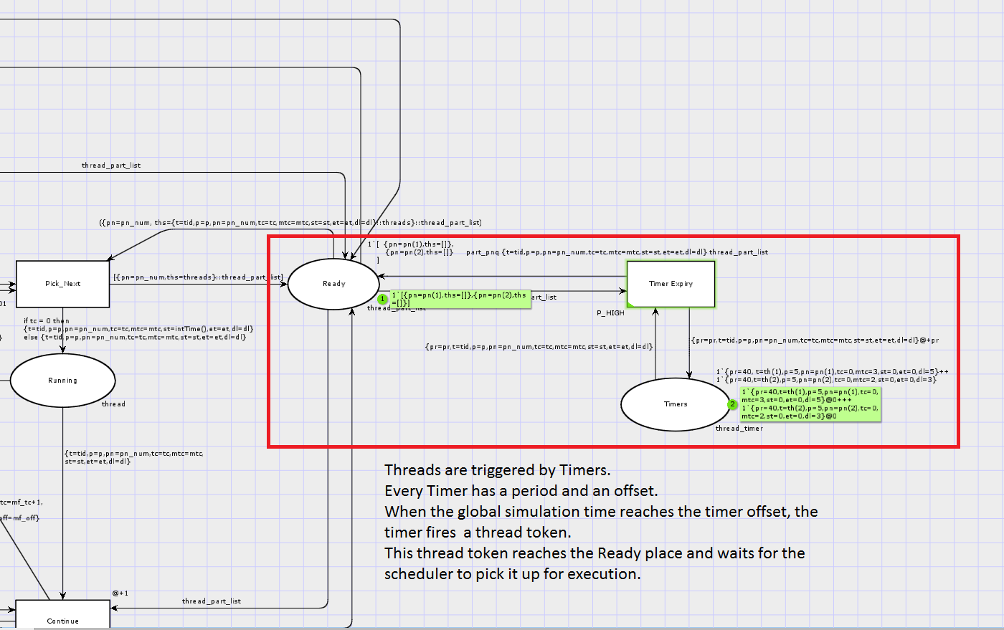

Slide 5
Modeling Partition Scheduling
The Temporal Partition Schedule is captured as follows:
Each Partition has:
Partition Number.
Duration -- Number of ticks for which the minor frame is active.
Period
Offset
Each schedule has:
List of Partitions [Ordered].
Hyperperiod
Major Frame count – to update and manage partition offsets.

Slide 6
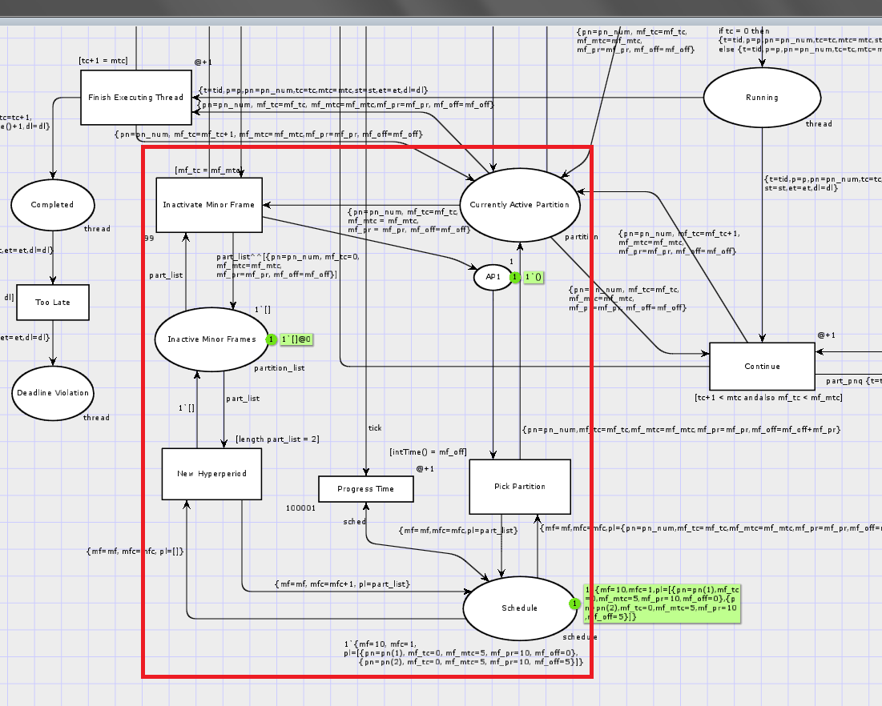

Slide 7
Modeling Scheduler
Scheduler runs one tick at a time.
At each tick:
Updates the currently active partition; Inactivates partition if required.
Looks at all ready threads associated with currently active partition.
Chooses the highest priority thread.
If thread is running for first time, marks global time stamp as thread start time.
Runs this thread for one tick.
Updates thread tick count.
Checks if thread execution is complete.
If yes, then marks thread as complete.
Marks global time stamp as thread end time.
Goto 1.

Slide 8
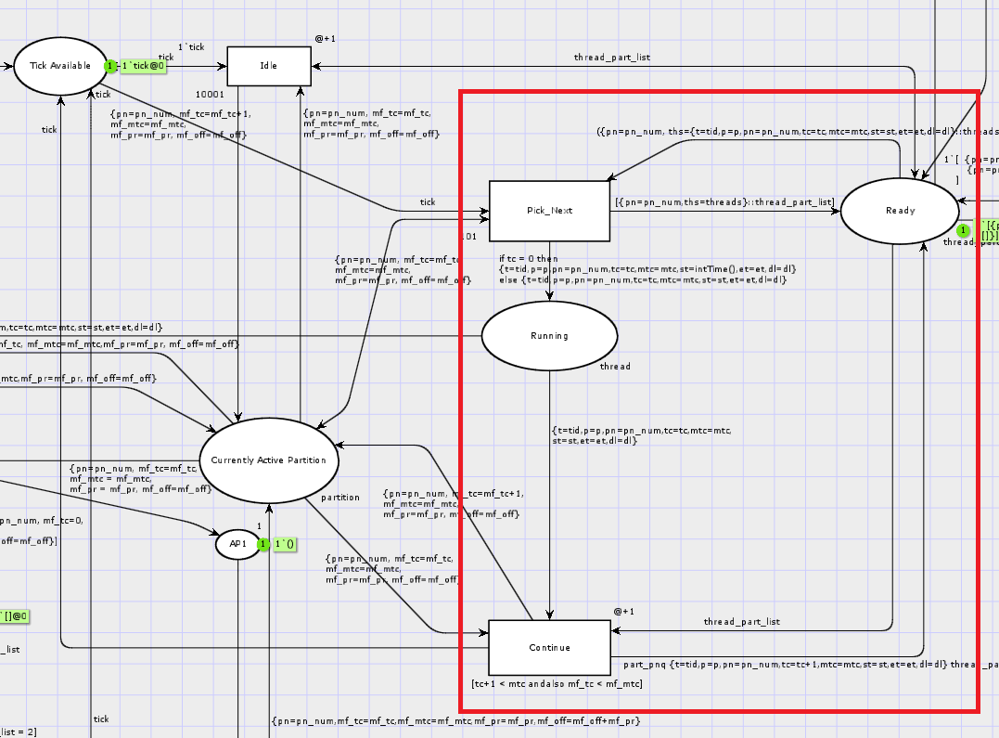

Slide 9
Demonstration of Model Capabilities

